Slide 1



Theme: Smart Education
STUDYSNAP
By: ByteCloud
-
from overwhelmed to exam-ready

Slide 2
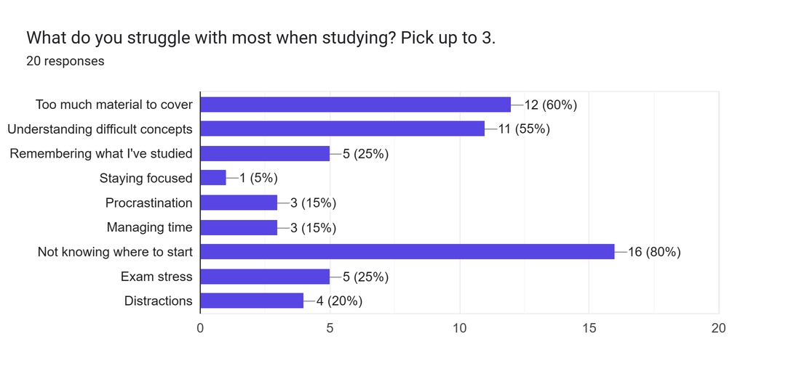
THE PROBLEM
Problem
Evidence
  Meet A, a 2nd-year UM student: 14 weeks of slides, hundreds of pages, before finals.
  Her first study hour goes to figuring out what matters — not learning.
  No easy way to test herself.
In our poll of 20 classmates, 80% named “not knowing where to start” their biggest study struggle - the top answer, above procrastination (15%) and staying focused (5%).

Slide 3
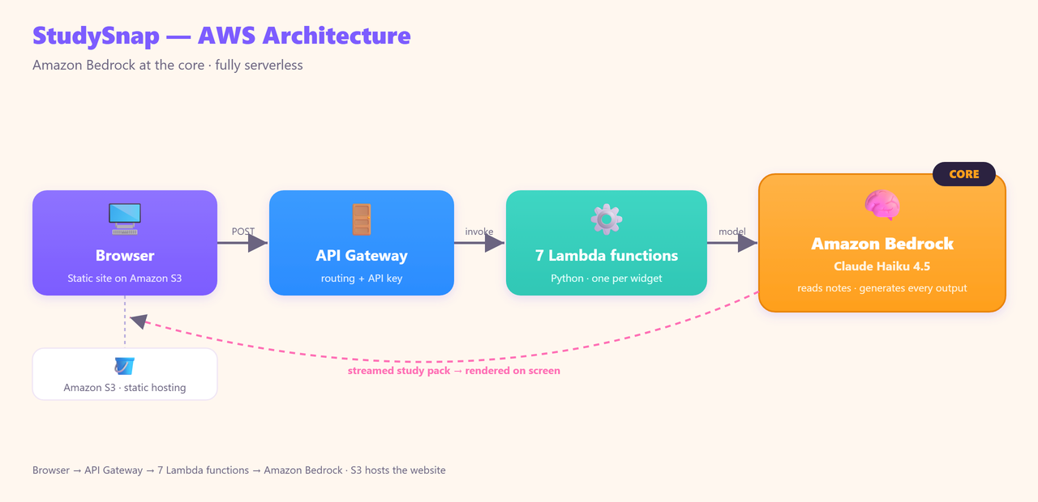
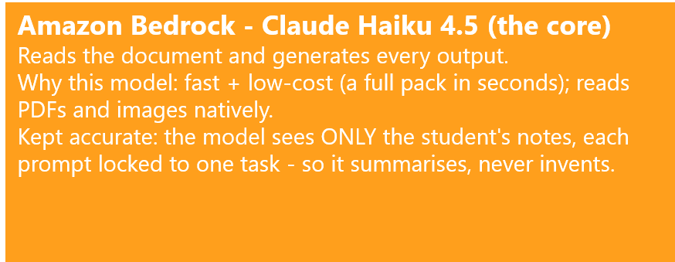
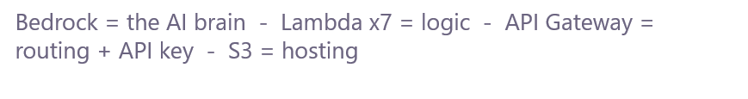
  SOLUTION, BUILT ON AWS
  Why it needs AI
  Built on AWS
  Every student's notes are different — only a language model can read your notes and decide what matters.
  Today students juggle between ChatGPT, Quizlet, and highlighters.
  StudySnap does what they can't: one upload → summary, flashcards, glossary, examples, difficulty tags, quiz, and a tutor chat — all from your material.

Slide 4
  REAL IMPACT, READY TO GROW
  01. Impact
  02. Who pilots it?
  03. How it grows?
  Full study pack in ~40 seconds.
  The hour spent organising → now spent learning.
  Est. ~12-15 hours saved per student per semester (≈1 hour/week × 14 weeks).
  Enters the exam having actually self-tested.
  Works end to end today (you just saw it).
  First pilot: UM's Academic Strategic Planning Department (ASPD) - it owns academic strategy & digital learning (SPeCTRUM) campus-wide.
  Fits how they already work: they hand out revision material - now they point to StudySnap.
  Any course with notes: medicine, law, schools, corporate training.
  Serverless = pay per request.
  ~25-30 sen per study pack → a class of 40 costs RM 10-12; pay only when it is used.

Slide 5


Thank
You

